Slide 1
Input/output…
Anisha P Rodrigues, DEPT OF CSE, NMAMIT, Nitte

Slide 2
Java programs perform I/O through streams
A stream is a sequence of bytes (or data or objects) that flow from a source to a destination
A stream is an abstraction that either produces or consumes information
A stream is linked to a physical device by the Java I/O system
All streams behave in the same manner, even if the actual physical devices to which they are linked differ
Anisha P Rodrigues, Dept of CSE, NMAMIT, Nitte

Slide 3
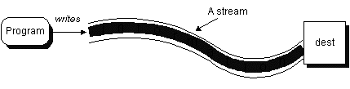
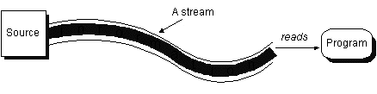
Anisha P Rodrigues, DEPT OF CSE, NMAMIT, Nitte

Slide 4
Thus, the same I/O classes and methods can be applied to any type of device
This means that an input stream can abstract many different kinds of input: from a disk file, a keyboard, or a network socket
Likewise, an output stream may refer to the console, a disk file, or a network connection
Anisha P Rodrigues, Dept of CSE, NMAMIT, Nitte

Slide 5
Java defines two types of streams: byte and character
Byte streams provide a convenient means for handling input and output of bytes
Byte streams are used, for example, when reading or writing binary data
Character streams provide a convenient means for handling input and output of characters
Anisha P Rodrigues, Dept of CSE, NMAMIT, Nitte

Slide 6
Byte Streams
Program
01101001
11101101
00000000
Device
Character Streams
Program
I
‘
M
A
S
T
R
I
N
G
\n
Device
Anisha P Rodrigues, DEPT OF CSE, NMAMIT, Nitte

Slide 7
Byte streams are defined by using two class hierarchies
At the top are two abstract classes: InputStream and OutputStream
Each of these abstract classes has several concrete subclasses that handle the differences between various devices, such as disk files, network connections, and even memory buffers
Anisha P Rodrigues, Dept of CSE, NMAMIT, Nitte

Slide 8
Character streams are defined by using two class hierarchies
At the top are two abstract classes, Reader and Writer
These abstract classes handle Unicode character streams
Java has several concrete subclasses of each of these
Anisha P Rodrigues, Dept of CSE, NMAMIT, Nitte

Slide 9
By I/O Directions:
  for Input => Input
  for output => Output
By datatype of stream content
  char data => Reader / Writer
  byte data => InputStream / OutputStream
  other primitive data(int, long, float,…) => DataInputStream /DataOutputStream
  Objects => ObjectInputStream /ObjectOutputStream
Anisha P Rodrigues, DEPT OF CSE, NMAMIT, Nitte

Slide 10
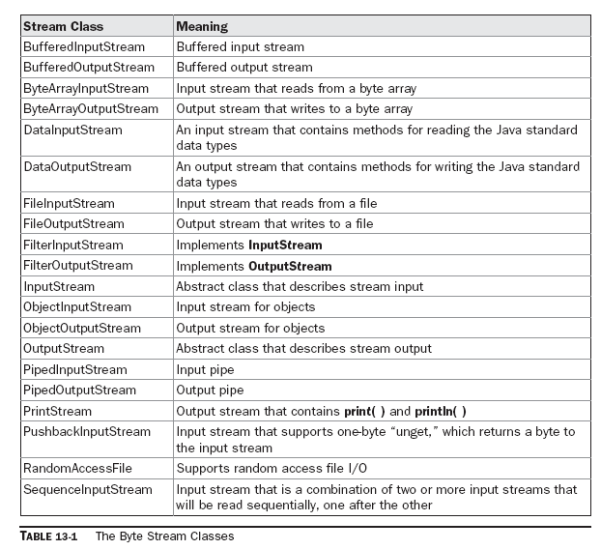
Anisha P Rodrigues, Dept of CSE, NMAMIT, Nitte

Slide 11
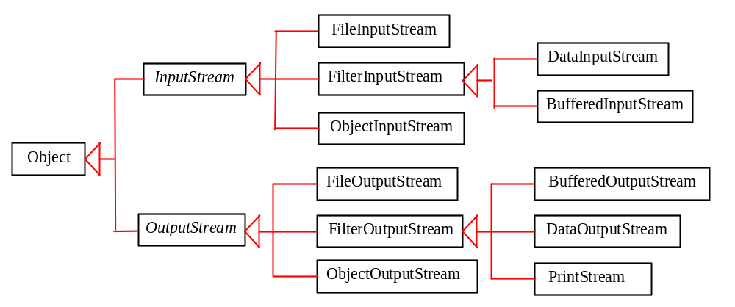
Byte Input / Output Classes
Anisha P Rodrigues, DEPT OF CSE, NMAMIT, Nitte

Slide 12
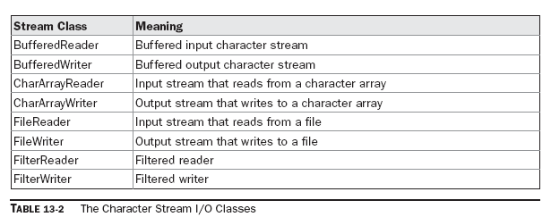
Anisha P Rodrigues, Dept of CSE, NMAMIT, Nitte

Slide 13
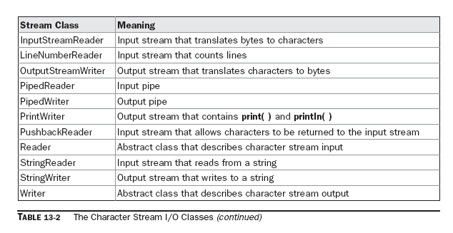
Anisha P Rodrigues, Dept of CSE, NMAMIT, Nitte

Slide 14
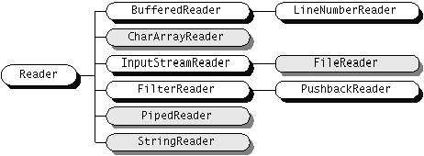
Anisha P Rodrigues, DEPT OF CSE, NMAMIT, Nitte

Slide 15
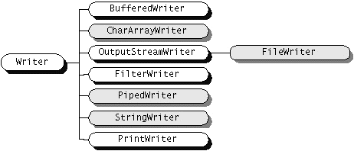
Anisha P Rodrigues, DEPT OF CSE, NMAMIT, Nitte

Slide 16
All Java programs automatically import the java.lang package
This package defines a class called System, which encapsulates several aspects of the run-time environment
Anisha P Rodrigues, Dept of CSE, NMAMIT, Nitte

Slide 17
System also contains three predefined stream variables: in, out, and err
These fields are declared as public, static, and final within System
This means that they can be used by any other part of your program and without reference to a specific System object
Anisha P Rodrigues, Dept of CSE, NMAMIT, Nitte

Slide 18
System.out refers to the standard output stream
By default, this is the console
System.in refers to standard input, which is the keyboard by default
System.err refers to the standard error stream, which also is the console by default
However, these streams may be redirected to any compatible I/O device
Anisha P Rodrigues, Dept of CSE, NMAMIT, Nitte

Slide 19
System.in is an object of type InputStream
System.out and System.err are objects of type PrintStream
These are byte streams, even though they typically are used to read and write characters from and to the console
Anisha P Rodrigues, Dept of CSE, NMAMIT, Nitte

Slide 20
Reading Console Input…
In Java, console input is accomplished by reading from System.in
To obtain a character based stream that is attached to the console, wrap System.in in a BufferedReader object
BufferedReader supports a buffered input stream Its most commonly used constructor :
BufferedReader(Reader inputReader)
Anisha P Rodrigues, Dept of CSE, NMAMIT, Nitte

Slide 21
Here, inputReader is the stream that is linked to the instance of BufferedReader that is being created
Reader is an abstract class
One of its concrete subclasses is InputStreamReader, which converts bytes to characters
Anisha P Rodrigues, Dept of CSE, NMAMIT, Nitte

Slide 22
To obtain an InputStreamReader object that is linked to System.in, use the following constructor:
InputStreamReader(InputStream inputStream)
Because System.in refers to an object of type InputStream, it can be used for inputStream.
Anisha P Rodrigues, Dept of CSE, NMAMIT, Nitte

Slide 23
Putting it all together, the following line of code creates a BufferedReader that is connected to the keyboard:
BufferedReader d = new BufferedReader ( new InputStreamReader(System.in));
After this statement executes, d is a character-based stream that is linked to the console through System.in
Anisha P Rodrigues, Dept of CSE, NMAMIT, Nitte

Slide 24
Reading Characters…
// Use a BufferedReader to read characters from the console.
import java.io.*;
class BRRead {
public static void main(String args[]) throws IOException
{
char c;
BufferedReader d = new BufferedReader(new InputStreamReader(System.in));
System.out.println("Enter characters, 'q' to quit.");
// read characters
do {
c = (char) d.read();
System.out.println(c);
} while(c != 'q');
}
}
Anisha P Rodrigues, Dept of CSE, NMAMIT, Nitte

Slide 25
Reading Strings…
To read a string from the keyboard, use the version of readLine( ) that is a member of the BufferedReader class
Its general form is shown here:
String readLine( ) throws IOException
it returns a String object.
Anisha P Rodrigues, Dept of CSE, NMAMIT, Nitte

Slide 26
// Read a string from console using a BufferedReader.
import java.io.*;
class BRReadLines {
public static void main(String args[])
throws IOException
{
// create a BufferedReader using System.in
BufferedReader d = new BufferedReader(new InputStreamReader(System.in));
String str;
System.out.println("Enter lines of text.");
System.out.println("Enter 'stop' to quit.");
do {
str = d.readLine();
System.out.println(str);
} while(!str.equals("stop"));
}
}
Anisha P Rodrigues, Dept of CSE, NMAMIT, Nitte

Slide 27
We can use DataInputStream class also…
DataInputStream d = new DataInputStream(System.in);
    :
    String s = d.readLine()
    :
    :
DataInputStream reads bytes from the stream and converts them into appropriate primitive type values or strings.
Anisha P Rodrigues, Dept of CSE, NMAMIT, Nitte

Slide 28
static double Double.parseDouble(String str)
throws NumberFormatException
Returns the double equivalent of the number contained in the string specified by str using radix 10
Anisha P Rodrigues, Dept of CSE, NMAMIT, Nitte

Slide 29
static String toString(double num)
Returns the string equivalent of the value specified by num
Anisha P Rodrigues, Dept of CSE, NMAMIT, Nitte

Slide 30
static int Integer.parseInt(String str) throws NumberFormatException
Returns the integer equivalent of the number contained in the string specified by str using radix 10.
Anisha P Rodrigues, Dept of CSE, NMAMIT, Nitte

Slide 31
static String toString(int num)
Returns a string that contains the decimal equivalent of num
Anisha P Rodrigues, Dept of CSE, NMAMIT, Nitte

Slide 32
static float Float.parseFloat(String str) throws NumberFormatException
Returns the float equivalent of the number contained in the string specified by str using radix 10
Anisha P Rodrigues, Dept of CSE, NMAMIT, Nitte

Slide 33
static String toString(float num)
Returns the string equivalent of the value specified by num
Anisha P Rodrigues, Dept of CSE, NMAMIT, Nitte

Slide 34
static long parseLong(String str) throws NumberFormatException
Returns the long equivalent of the number contained in the string specified by str in radix 10
Anisha P Rodrigues, Dept of CSE, NMAMIT, Nitte

Slide 35
static String toString(long num)
Returns a string that contains the decimal equivalent of num
Anisha P Rodrigues, Dept of CSE, NMAMIT, Nitte

Slide 36
static Long valueOf(long num)
Returns a Long object containing the value passed in num.
static Long valueOf(String str) throws NumberFormatException
Returns a Long object that contains the value specified by the string in str
Anisha P Rodrigues, Dept of CSE, NMAMIT, Nitte

Slide 37
static Integer valueOf(int num)
Returns an Integer object containing the value passed in num.
static Integer valueOf(String str) throws NumberFormatException
Returns an Integer object that contains the value specified by the string in str
Anisha P Rodrigues, Dept of CSE, NMAMIT, Nitte

Slide 38
static Float valueOf(float num)
Returns a Float object containing the value passed in num.
static Float valueOf(String str) throws NumberFormatException
Returns the Float object that contains the value specified by the string in str
Anisha P Rodrigues, Dept of CSE, NMAMIT, Nitte

Slide 39
static Double valueOf(double num)
Returns a Double object containing the value passed in num.
static Double valueOf(String str) throws NumberFormatException
Returns a Double object that contains the value specified by the string in str
Anisha P Rodrigues, Dept of CSE, NMAMIT, Nitte

Slide 40
float floatValue( )
Returns the value of the invoking object as a float
Similarly
double doubleValue( )
long longValue( )
int intValue( )
Anisha P Rodrigues, Dept of CSE, NMAMIT, Nitte

Slide 41
Example…
Float.valueOf(param).floatValue();
Param could be String or float number…
Anisha P Rodrigues, Dept of CSE, NMAMIT, Nitte

Slide 42
import java.io.*;
class A1
{
int a, b;
public static void main(String args[])
{
A1 obj = new A1();
DataInputStream in = new DataInputStream(System.in);
String s = new String();
// String s = null;
try
{
s = in.readLine();
}
catch(IOException ie)
{ }
Anisha P Rodrigues, Dept of CSE, NMAMIT, Nitte

Slide 43
try
{
obj.a = Integer.parseInt(s);
obj.b = obj.a + 20;
System.out.println("a=" + obj.a + " b=" + obj.b);
int c;
c=Integer.valueOf(s).intValue();
c=c+1;
System.out.println("c=" + c);
}
catch(NumberFormatException ne)
{
System.out.println("Number Format Not Proper");
}
}
}
O/P:
a=10 b=30
c=11
Anisha P Rodrigues, Dept of CSE, NMAMIT, Nitte

Slide 44
Writing Console Output…
The simplest form of write( ) defined by PrintStream is shown here:
void write(int byteval)
This method writes to the stream the byte specified by byteval
Although byteval is declared as an integer, only the low-order eight bits are written
Anisha P Rodrigues, DEPT OF CSE, NMAMIT, Nitte

Slide 45
Here is a short example that uses write() to output the character “A” followed by a newline to the screen:
// Demonstrate System.out.write().
class WriteDemo {
public static void main(String args[]) {
int b;
b = 'A';
System.out.write(b);
System.out.write('\n');
}
}
Anisha P Rodrigues, DEPT OF CSE, NMAMIT, Nitte

Slide 46
The PrintWriter Class…
PrintWriter is one of the character-based classes
PrintWriter supports the print() and println() methods for all types including Object
Thus, you can use these methods in the same way as they have been used with System.out
If an argument is not a simple type, the PrintWriter methods call the object’s toString() method and then print the result
Anisha P Rodrigues, DEPT OF CSE, NMAMIT, Nitte

Slide 47
The following application illustrates using a PrintWriter to handle console output:
import java.io.*;
public class PrintWriterDemo {
public static void main(String args[]) {
PrintWriter pw = new PrintWriter(System.out, true);
pw.println("This is a string");
int i = -7;
pw.println(i);
double d = 4.5e-7;
pw.println(d);
}
}
The output from this program is shown here:
This is a string
-7
4.5E-7
Anisha P Rodrigues, DEPT OF CSE, NMAMIT, Nitte

Slide 48
Thank You…
Anisha P Rodrigues, DEPT OF CSE, NMAMIT, Nitte

